Slide 1


ESSAYGAN
(PAPER REVIEW)
By, Rahul Kumar

Slide 2
Automated Essay Scoring (AES)
Relieves human raters from spending enormous amount of time and effort for essay grading according to a rubric.
AES systems based on a deep learning architecture can achieve better performance than traditional systems by mitigating difficulties of feature selection in most cases.
An AES system built on a deep learning architecture requires human-rated essays for training but creating a cutting-edge grading system
Enhances
Writing skills
Can be
Constrained
Expensive cost of collecting
human-rated essays

Slide 3
EssayGAN
Automatic data augmentation provides solution to the chronic problem of a lack of training of data.
The authors proposed an automatic essay generator based on generative adversarial networks (GANs), called EssayGAN to augment training data automatically for AES systems.
Conventional GANs consist of two sub-networks: a generator that produces fake data and a discriminator that differentiates real from fake data.
The goal of the generator is to generate data that the discriminator believes to be real.

Slide 4
To generate essays rated with different scores, EssayGAN has multiple generators and a discriminator.
Number of generators is determined based on score range used for essay grading.
Each generator is dedicated to producing only essays with a specific score.
The discriminator is trained to distinguish between real and generated essays.

Slide 5

Essay generation through EssayGAN is the sequence of prediction of the next sentence based on previously chosen sentences.
EssayGAN predicts the next sentence whereas an ordinary-text GAN model predicts the next word at each step.
For a specific score, EssayGAN can generate as many essays as necessary. As a result, it can offer a training dataset large enough to train AES systems based on deep neural network-based.

Slide 6
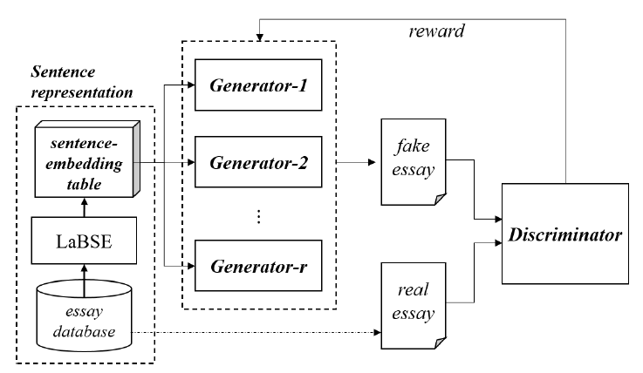
Process Architecture
EssayGAN composes a new essay by taking a sentence as it is, the newly generated essay differs from those of the training dataset.
Figure-1: Overall architecture of EssayGAN

Slide 7
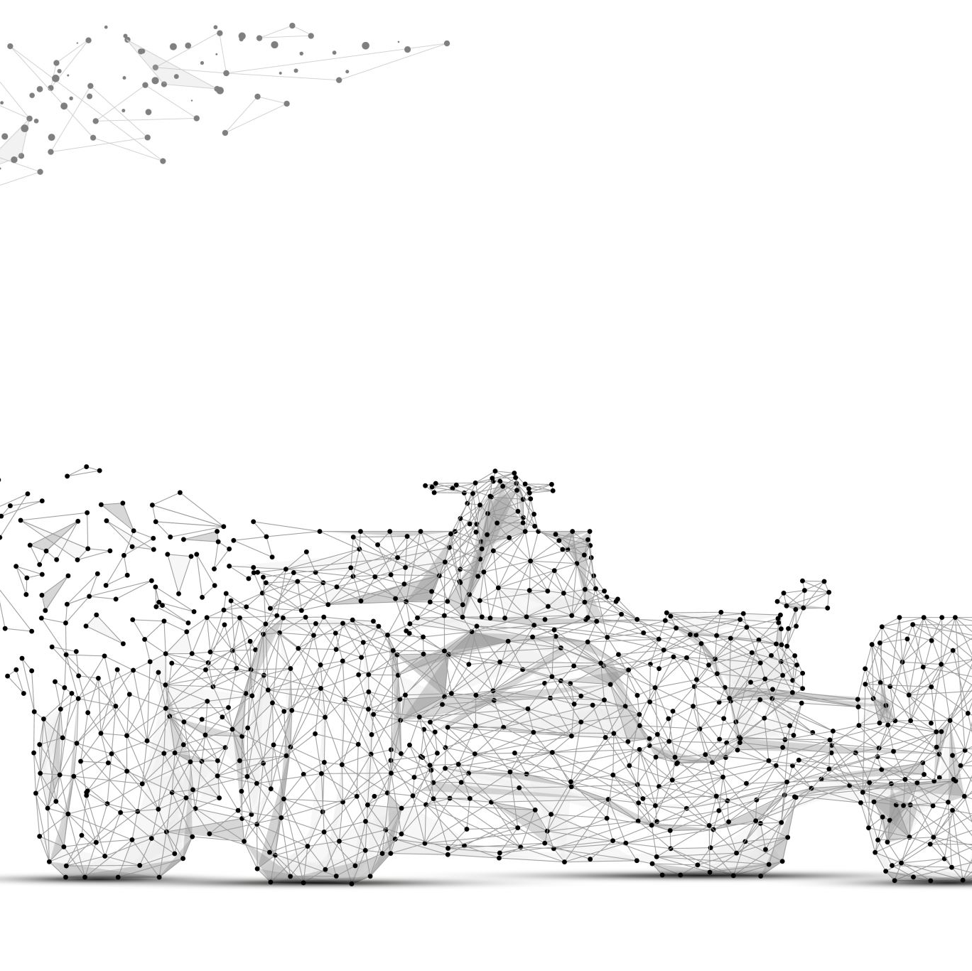
EssayGAN has multiple generators based on the range of scores, each generator can be trained only to compose essays corresponding to the selected score.
The discriminator is trained to distinguish whether an input essay is real or fake.
The quality of texts produced by each individual generator might be significantly increased as a result of the multiple generators assisting one another.

Slide 8
Each generator generates a fake essay that can deceive the discriminator while it discriminates between a real and a fake essay.
The generators can produce essays with the specified score because they have only been trained on a collection of essays that have been graded with the appropriate score.
So, instead of having to decide whether a generated essay is appropriate for the score, the discriminator can concentrate on determining whether the essay is real or fake.
Authors adopted a reinforcement learning method to train the generators.

Slide 9
Sentence Representation
EssayGAN's generators accept sentences as input, each sentence ought to be represented by a distinct embedding vector.
Authors adopted language-agnostic BERT sentence embedding (LaBSE) which produces language-agnostic cross-lingual sentence embeddings for 109 languages.
LaBSE uses the masked language model (MLM) and the translation language model (TLM) and is then fine-tuned using a translation ranking task. Finally, resulting model provides multilingual sentence embeddings in a single model.

Slide 10
The sentence embeddings of each sentence in the training data were calculated beforehand by the authors using LaBSE and afterwards the they were saved in a sentence-embedding table.
The EssayGAN generators and discriminator then used the embeddings to their advantage.

Slide 11

Discriminator
The discriminator's objective is to distinguish between human-written and generator composed essays.
The discriminator is built based on bi-directional LSTM networks.
The discriminator's output value is provided to the generators as a reward value.

Slide 12
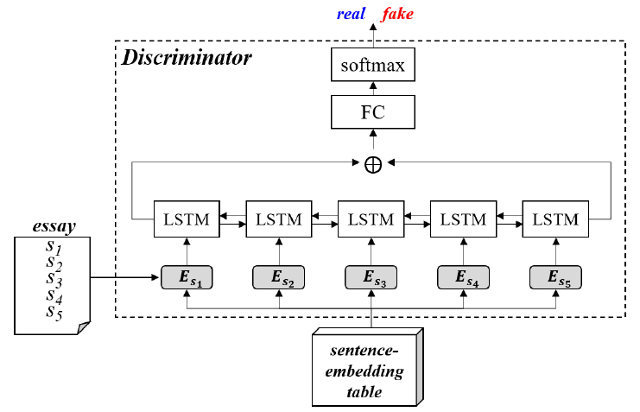
Figure-2: Architecture of discriminator used in EssayGAN

Slide 13
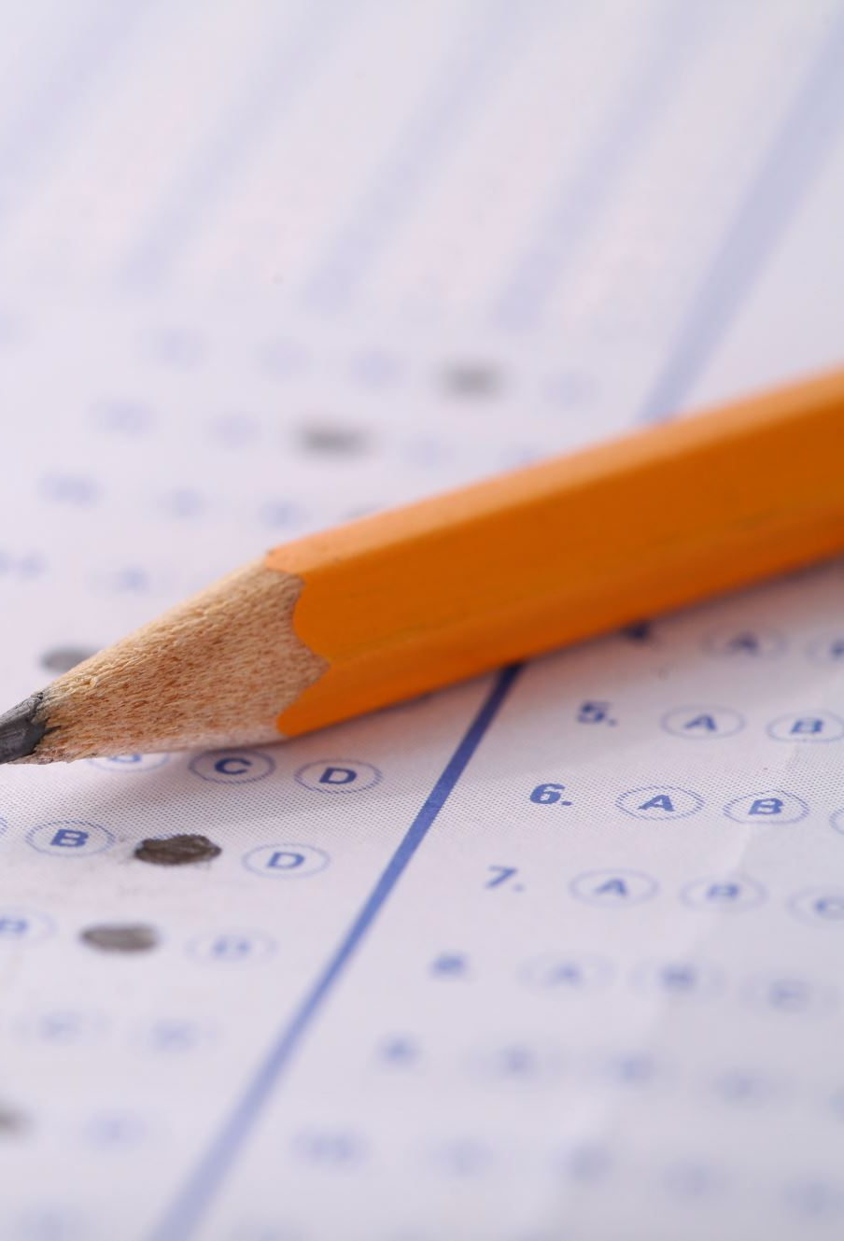
Training EssayGAN and Dataset
Authors used the Automated Student Assessment Prize (ASAP) dataset containing 12,978 essays on eight different prompts (essay topics) that were written by students from grades 7–10.
ASAP is considered as the de facto standard dataset in the AES domain for training and evaluation.

Slide 14
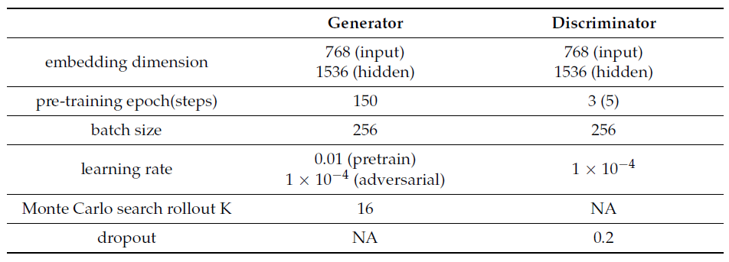
Table-1: Hyperparameters used for training EssayGAN

Slide 15

The number of generators in EssayGAN depends on the score range.
Authors limited the number of generators for EssayGAN to five to restrict shortage of data due to multiple generators for prompts having a broader score range.
The authors obtained a normalized score range by using the partitioning model.

Slide 16
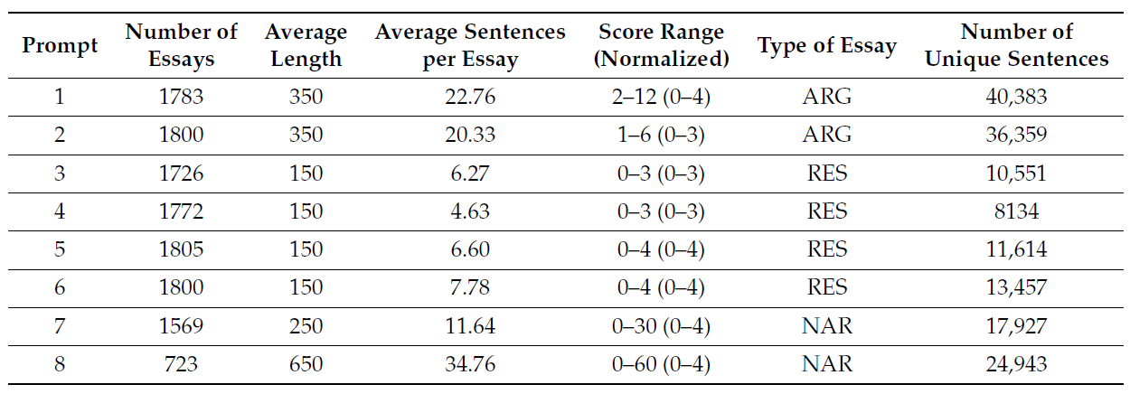
Table-2: Characteristics of the ASAP dataset
In the column “Type of essay”, ARG denotes argumentative essays, RES denotes source-dependent response essays, and NAR denotes narrative essays.

Slide 17
Thank You

